Slide 1
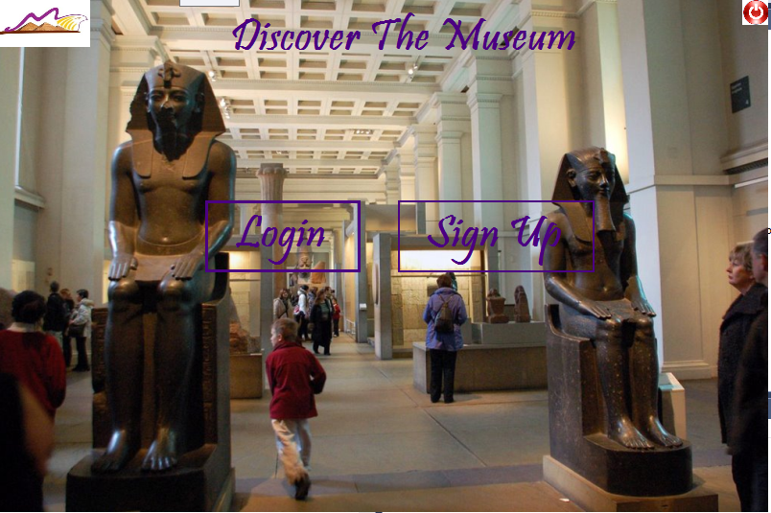
Wi-fi tracing position in museum
Supervisor:
Dr: Yousef Bsuny Mahdy
Notes:
تتبع موضع داخل المتحف ياستخدام تقنيه الواي فاي

Slide 2
Title and Content Layout with List
Abstract
Calculate the distance
Calculate the position
Show information
Application (admin and user) functions
The relationship between users and application

Slide 3
Abstract

Slide 4
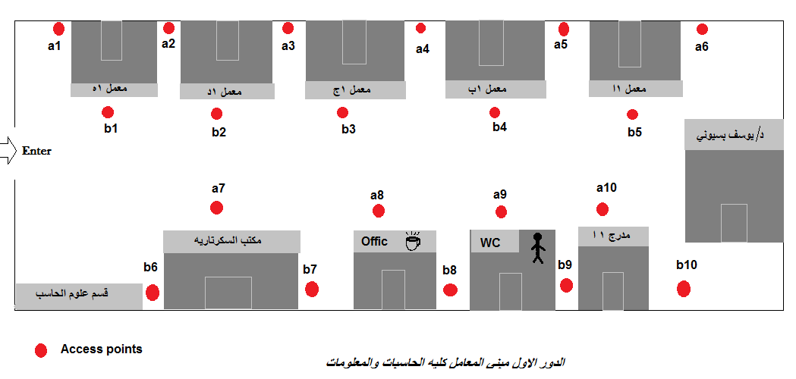
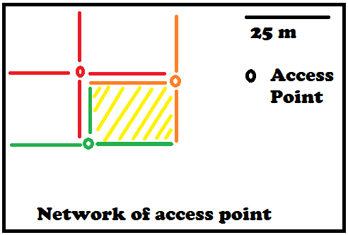
Abstract
We use network of access points to get indoor position, then sent information automatically about this position.

Slide 5
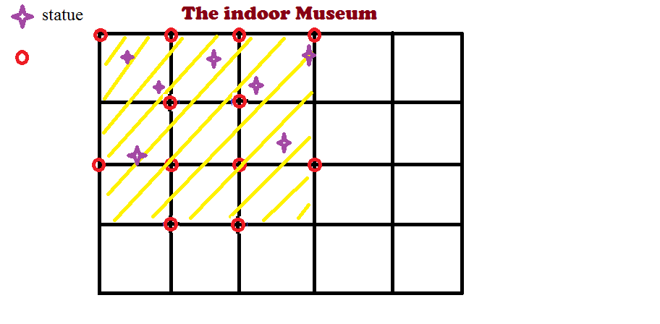
Abstract

Slide 6
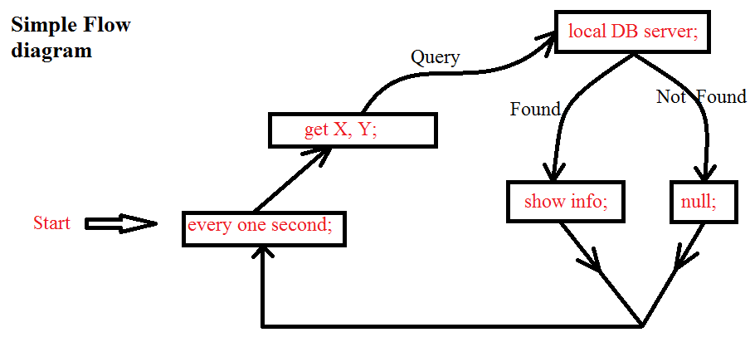
Abstract

Slide 7
Calculate the distance

Slide 8
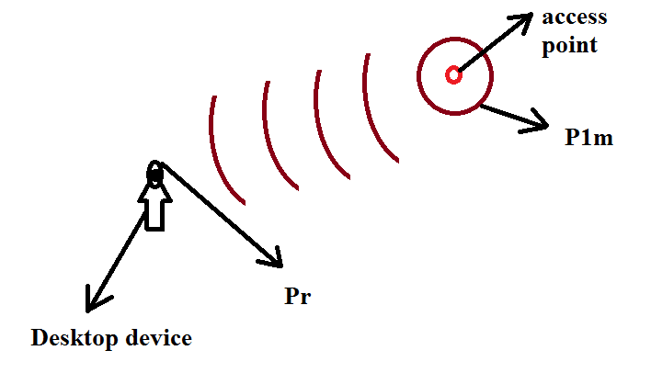
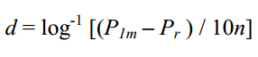
Calculate the distance
d ---→ distance between sender and receiver
P1m ---→ received signal strength at one meter (in dBm)
Pr --→ received signal strength (in dBm)
n ---→ attenuation factor for the environment

Slide 9
Calculate the position

Slide 10
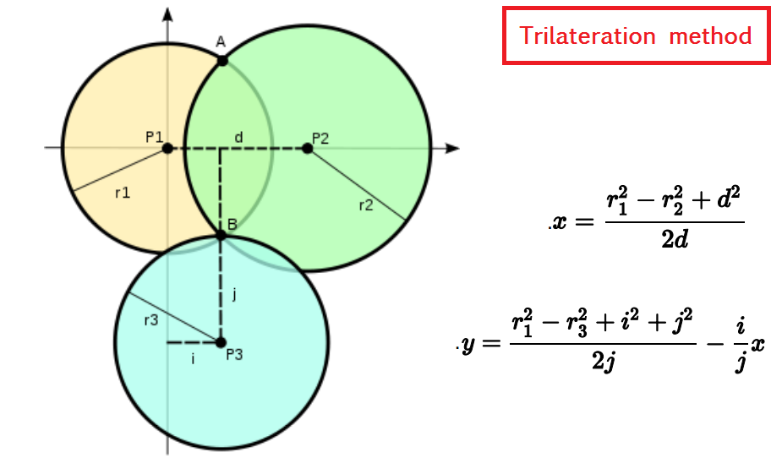
Calculate the position

Slide 11
Show information

Slide 12
Show Information
Steps :-
1]– I get location of tourist (x , y ) by calling function calculatePosition(List<rAP>) .
2]- I take x , y and Language that user choose and search to the match appropriate data about statue in database .
3]- I call this function that calculate position (x , y) every 6 seconds to update tourist location and send the data of the opposite statue to the tourist .

Slide 13
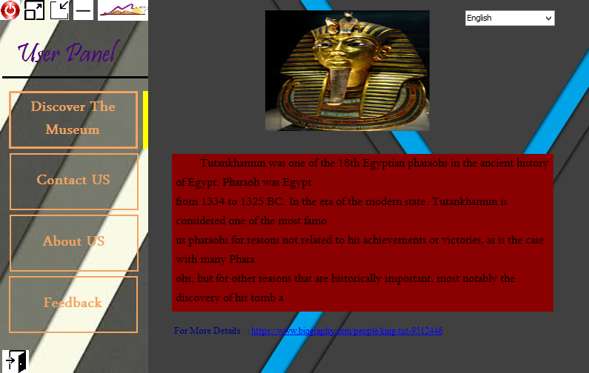
Show Information Continue (user)
User Location (0,0)
Choose English Language

Slide 14
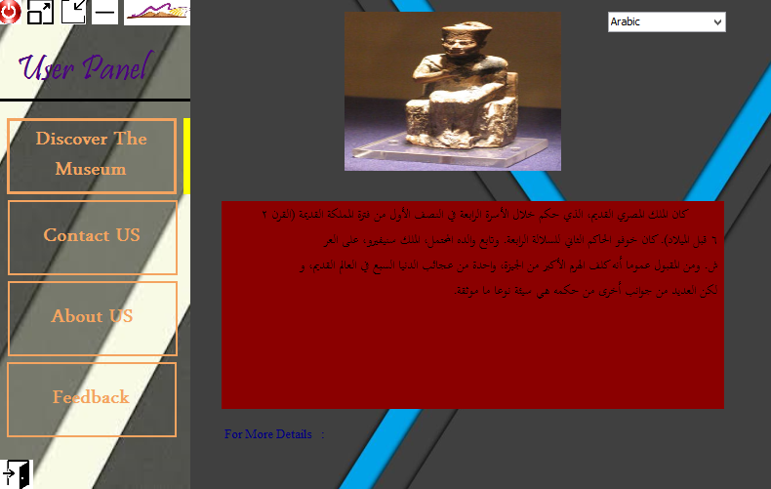
Show Information Continue (user)
User Location (5,0)
Choose Arabic Language

Slide 15
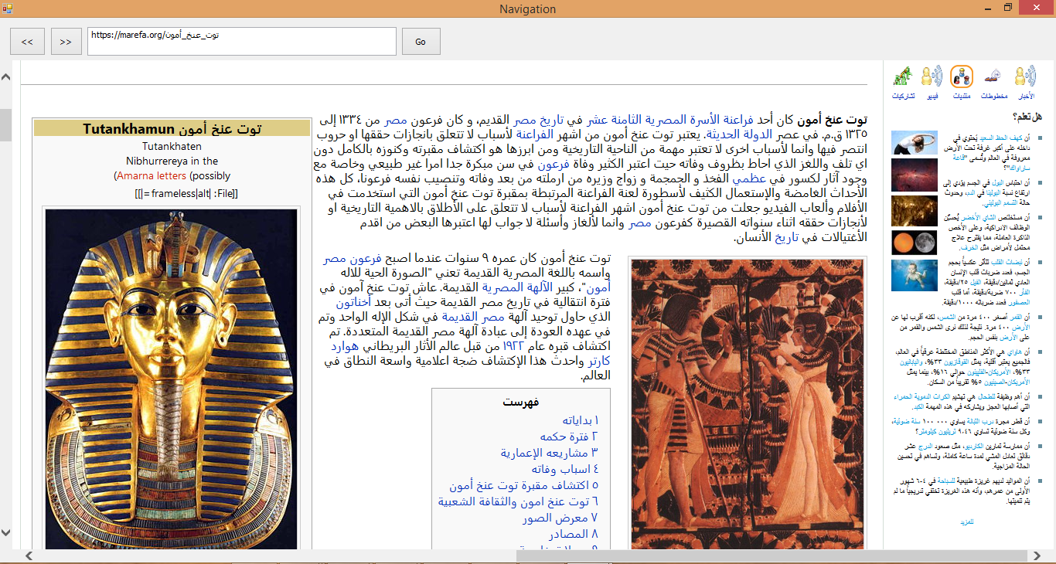
Show Information Continue (user)
I display link to the statue if the tourist wants to learn more about the statue

Slide 16
Show Information Continue (admin)
Admin can change data that concern the statue .
Steps :-
He enters as a admin
He enters id about statue that wants to change data that concern it .
After ends change ,presses save button .
Change will save in database .

Slide 17
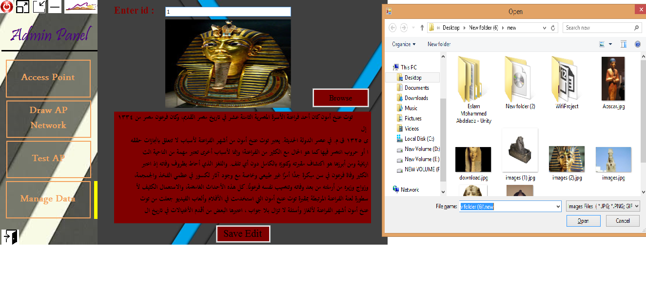
Show Information Continue (admin)

Slide 18
What About our Application (sign in and login)

Slide 19
sign in and login

Slide 20
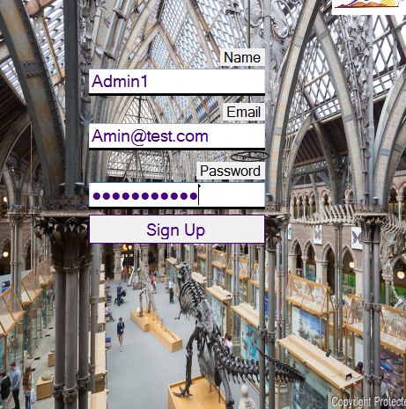
Sign in (user only)

Slide 21
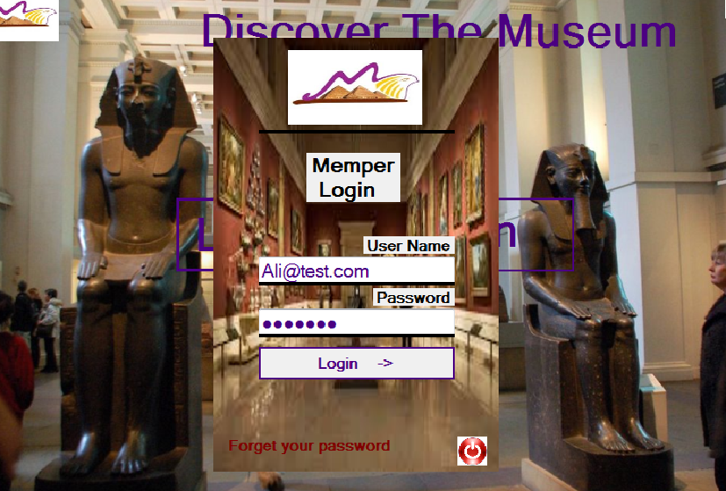
Login (Admin & user )

Slide 22
User or Admin
User or Admin determined from database
Admin is responsible for four tasks
1-Reading and storing Access points
2-Draw Access points Newtwork
3-Test Application
4-managing Data

Slide 23
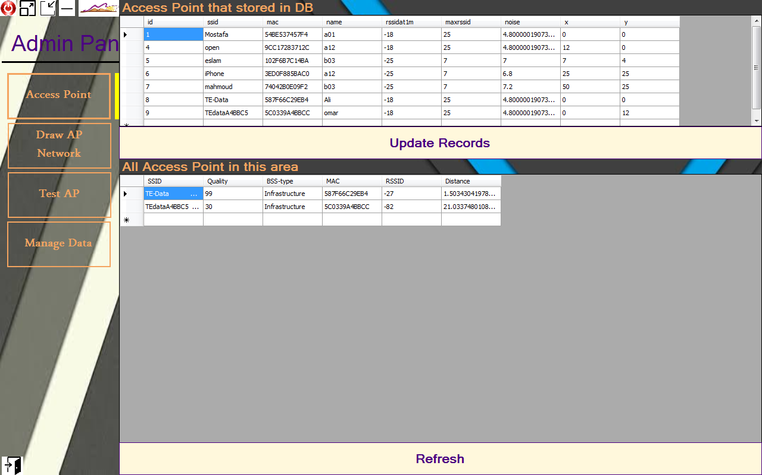
Reading and storing Access points

Slide 24
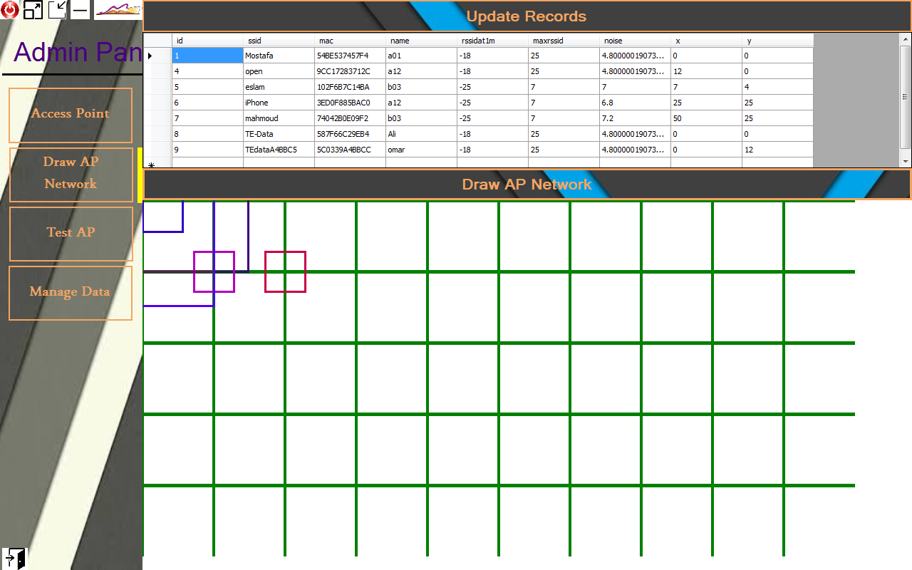
Draw AP Newtwork

Slide 25
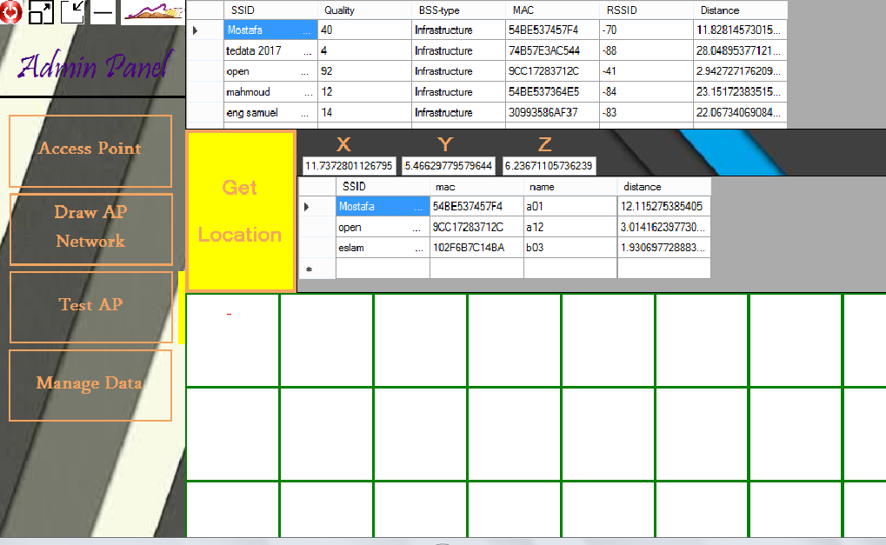
Test Ap Button (Calcuate the postion )

Slide 26
User
User can use this Application for :
1- Discover the museum
2- Contact us
3-Register his feedback about Application

Slide 27
Relation between Application and users

Slide 28
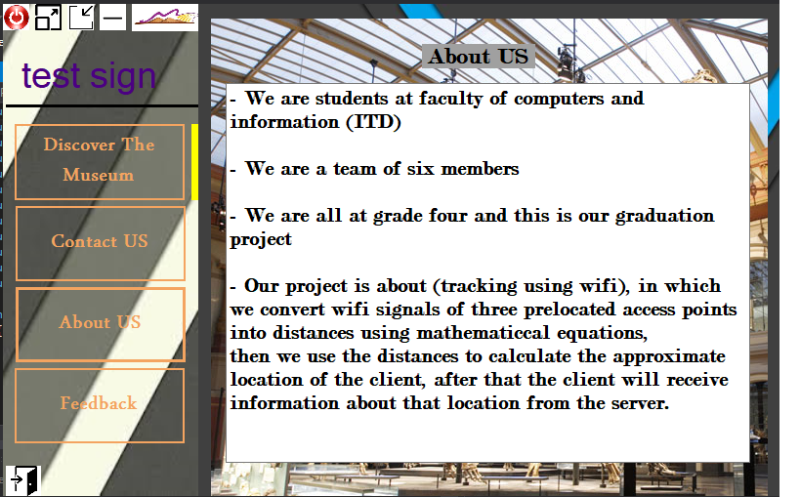
About us

Slide 29
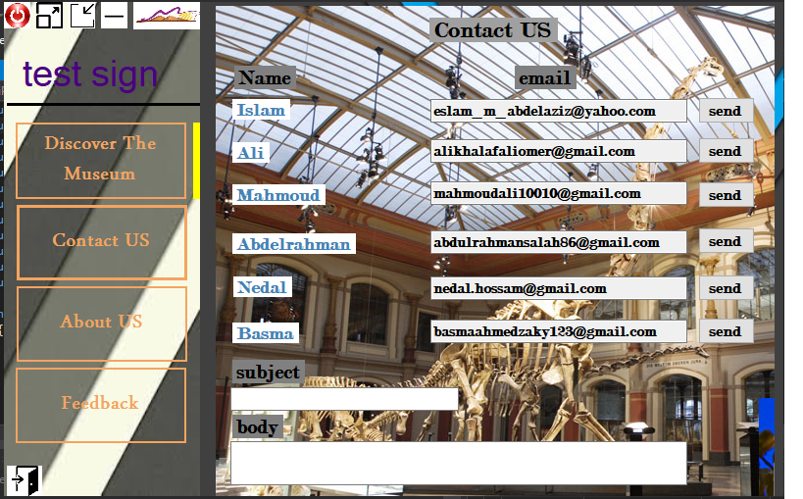
Contact us

Slide 30
Notice
In order to send email successfully, However you must allow for less secure applications :-
Use the following link:
https://myaccount.google.com/lesssecureapps

Slide 31
Feedback
Welcome constructive criticism

Slide 32
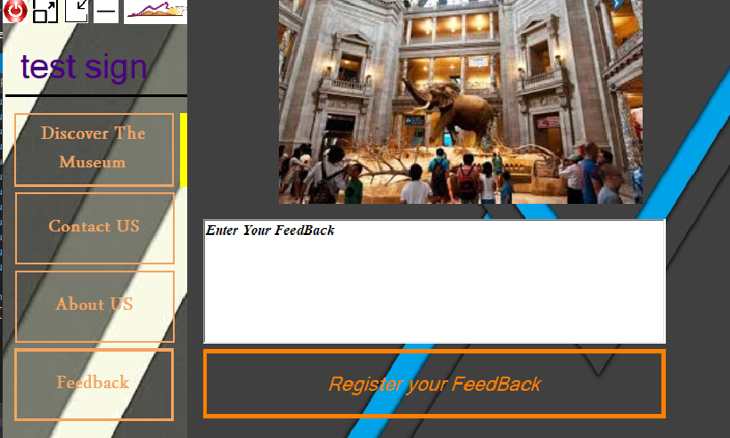
Feedback

Slide 33
Acknowledgements
We would like to express our thanks and gratitude to Prof Youssof Bassuny and the discussion committee.
We are pleases to present our graduation project to you and hope you enjoyed our project and receive your satisfaction.

Slide 34
Finally
Thanks for the nice viewing

Slide 35
Any Questions

